Slide 1

Vibrations and Sound
Chapter 17

Slide 2
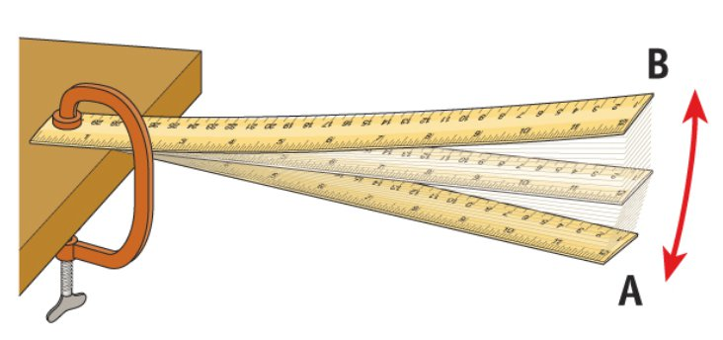
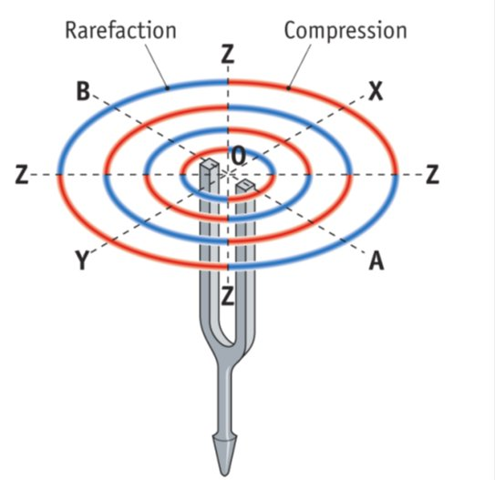
Every Source of Sound is a Vibrating Object.
E.g. a vibrating ruler.
A vibrating tuning fork.
A string on a guitar or piano.
A column of air as in a saxophone, tin whistle or recorder.
A paper cone in a loudspeaker.
The wings of a bee as it buzzes.

Slide 3
Sound travels as a Wave
The sound produced by a vibrating object travels away from the object as a wave.
Because sound travels as a wave it shows the usual wave properties i.e. sound can undergo:
Reflection Refraction
Diffraction Interference

Slide 4
Give an example of the Reflection of Sound.
An Echo is an example of sound undergoing reflection.

Slide 5
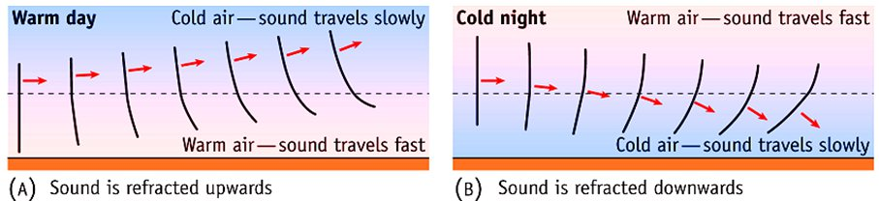
Refraction of Sound
The fact that sound can be heard more clearly on a cold night than on a warm day is an example of the Refraction of Sound.
On a warm day the air near the ground is warmer than the air higher up. Sound travels faster in warm air, i.e. near the ground. This causes the sound to be refracted upwards.
At night the air near the ground is cooler and the sound is refracted downwards.

Slide 6
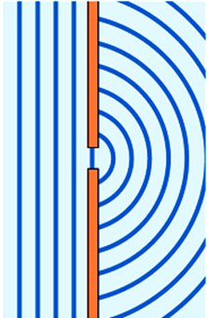
Sound undergoes Diffraction
When sound reaches a doorway it passes through and spreads out into the region at the other side of the doorway. This is sound undergoing diffraction.
The width of the doorway is near in size to the wavelength of sound, hence diffraction occurs.

Slide 7
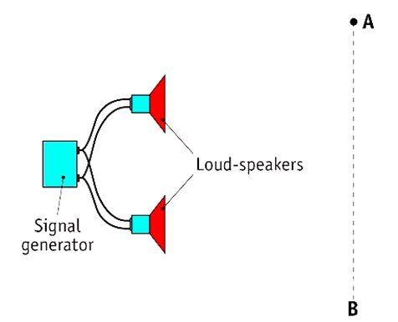
Experiment to show that Sound is a Wave Motion
Turn on the signal generator. Both speakers emit a note of the same frequency and amplitude.
Walk slowly from A to B.
You will hear the loudness of the sound increase and decrease regularly.
This shows the Interference of Sound.
Interference is evidence that sound is a wave motion.

Slide 8

How does sound travel through a medium?
Sound is produced by an object that is vibrating.
The vibrating object causes molecules next to it to vibrate.
These molecules in turn pass on the vibration to nearby molecules.
This process continues and the vibration passes through the medium.
This passing on of vibration from molecule to molecule is the sound travelling through the medium.
Note that since the direction of the molecules is parallel to the direction in which the sound travels, sound is a Longitudinal Wave.

Slide 9
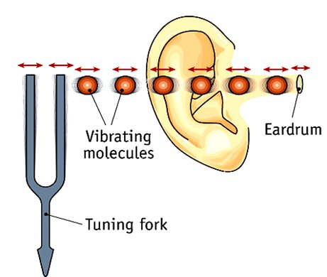
The vibrating tuning fork causes nearby molecules to vibrate.
These molecules in turn pass on the vibration to nearby molecules.
This vibration is eventually passed on to the ear drum of the ear, resulting in the sound being heard.

Slide 10

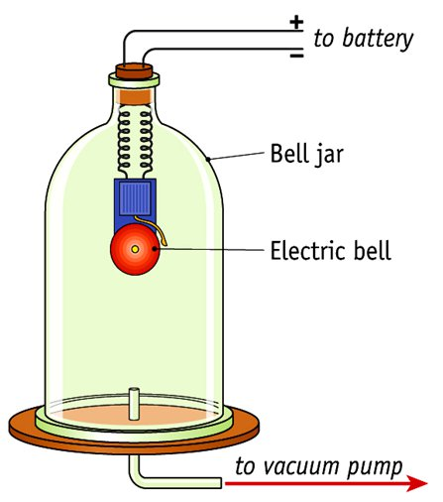
Experiment to show that Sound needs a Medium to Travel
Set the bell ringing.
Pump the air out of the bell jar.
The loudness of the sound decreases to barely audible.
Let the air back in and it can be heard again.
Conclusion: Sound needs a medium to travel.

Slide 11
Speed of Sound in Air
The speed of sound in air increases as the temperature does.
.
At 0 ºC the speed of sound in air is approximately 331 m s⁻¹.
At 20 ºC (typical room temperature) the speed of sound in air is approximately 344 m s⁻¹.

Slide 12
Speed of Sound in Different Materials
The speed at which sound travels through a medium depends on the elastic properties and the density of that medium.
In general the more dense the medium is the greater the speed.
Material | Approximate speed of sound ( in m s⁻¹ )
Air (0 ºC) | 331
Water | 1500
Copper | 3400
Steel | 4800

Slide 13

What are Overtones?
Frequencies that are multiples of a given frequency f are called Overtones of that frequency.
The frequency 2 f is called the First Overtone.
3 f is the Second Overtone.
4 f is the Third Overtone, etc.

Slide 14
What are the three main Characteristics of Musical Notes?
Loudness, Pitch and Quality
We all understand the meaning of the term “Loudness”.
A high note has High Pitch and a low note has Low Pitch.
Notes of the same pitch and loudness played on different musical instruments sound different. We say the notes have Different Quality.

Slide 15
State the physical property (i.e. the wave property) on which the Loudness, the Pitch and the Quality of a Musical Note depends.
The Loudness depends on the Amplitude.
The Pitch depends on the Frequency.
The Quality depends on the number of Overtones present and on the relative strengths of these overtones.

Slide 16
What are the Frequency Limits of Audibility?
The Frequency Limits of Audibility are the highest and lowest frequencies that can be heard by a normal human ear.
For a sound wave to be audible by a human its frequency must be between 20 Hz and 20 000 Hz. These values are the frequency limits of audibility.

Slide 17
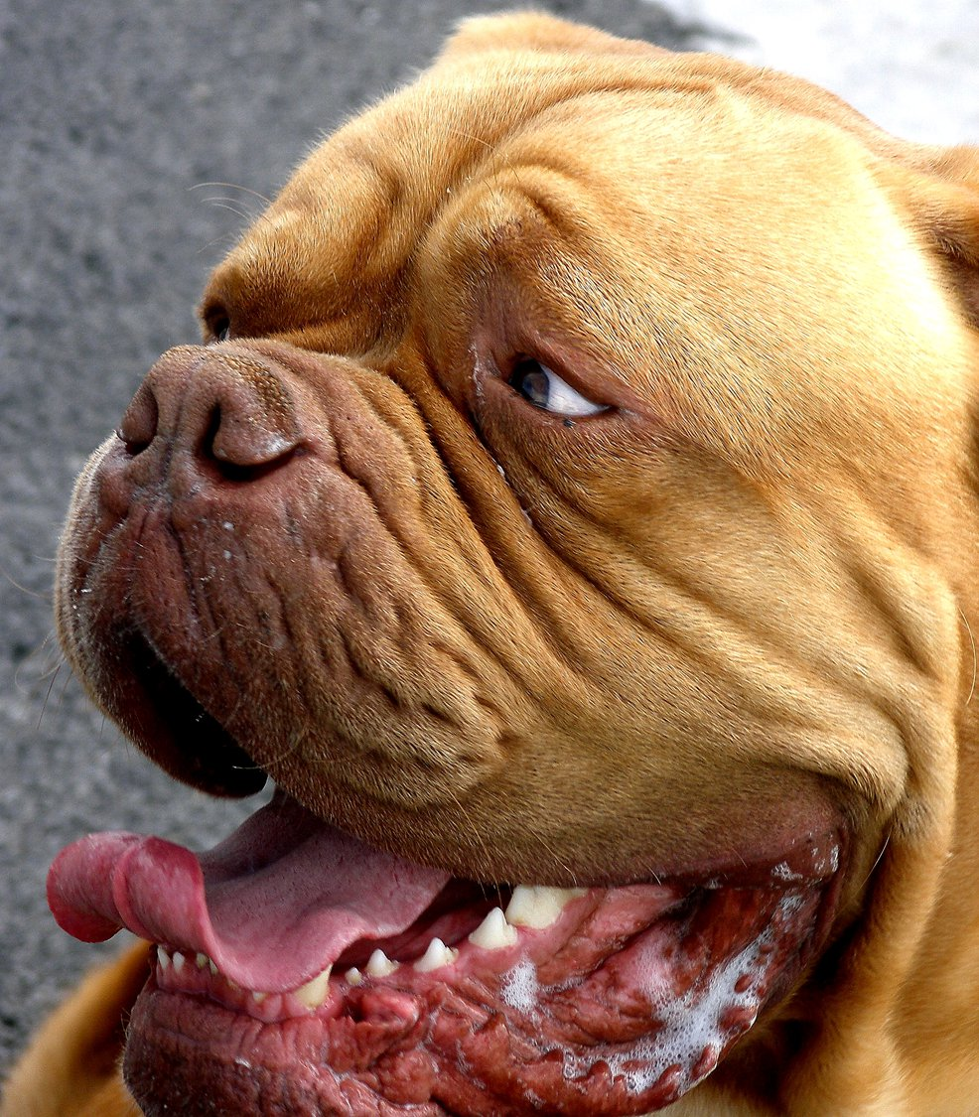
Ultrasound
Frequencies above 20 000 Hz are called Ultrasonic and cannot be heard by humans.
Dogs can hear frequencies up to about 35 000 Hz. Some dog whistles operate at frequencies above 20 000 Hz so that dogs and not humans can hear them.

Slide 18
What is meant by the Natural Frequency of an object?
The frequency at which an object vibrates when disturbed and allowed to vibrate freely is called its Natural Frequency of Vibration.

Slide 19
What is Resonance?
If the frequency of a periodic force applied to a body is the same as or very near to its natural frequency that body will vibrate with very large amplitude. This phenomenon is called Resonance.
Resonance is the transfer of energy from one body to another that have the same natural frequency.

Slide 20
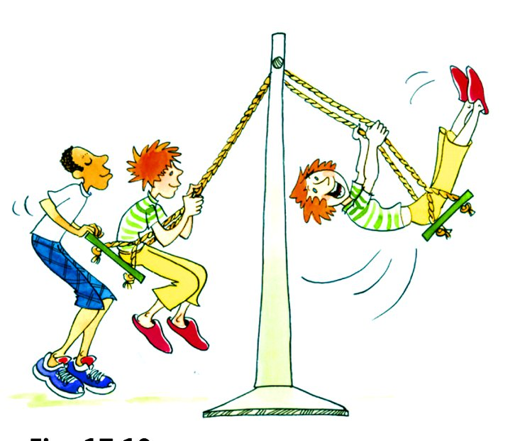

Slide 21
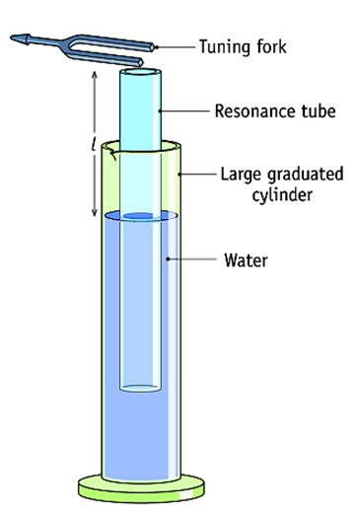
Experiment to Show Resonance
Use the equipment shown in the diagram.
Hold the vibrating fork over the tube and adjust the length of the tube.
Loud sound will be heard at certain lengths.
This is the air column in the tube resonating with the tuning fork.

Slide 22
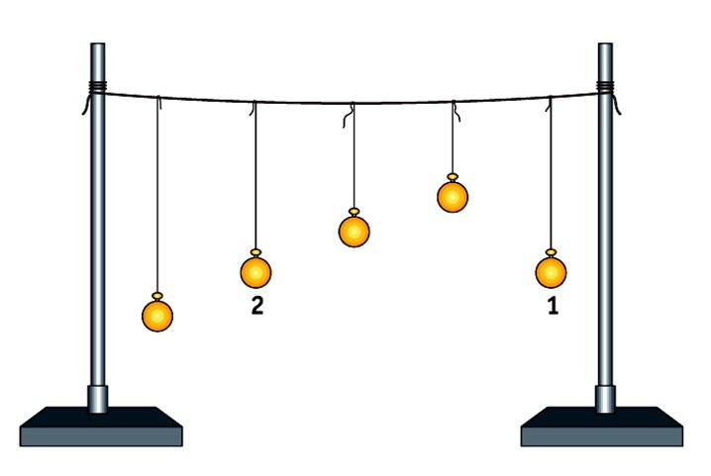
Example of Resonance: Barton’s Pendulums

Slide 23
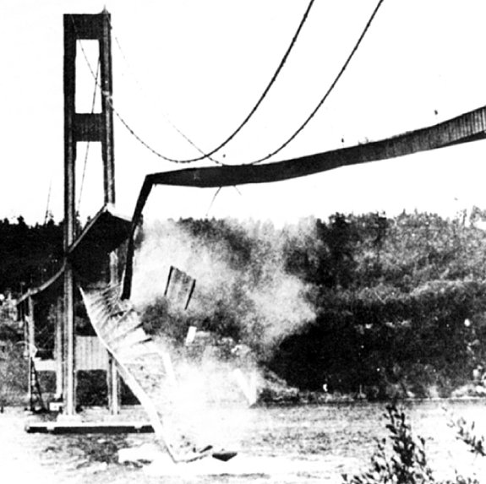
Tacoma Narrows Bridge

Slide 24
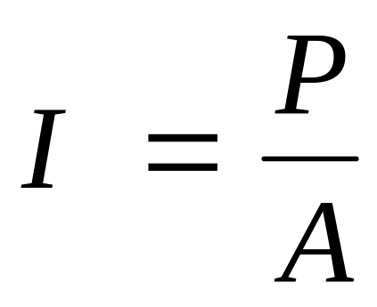

What is meant by Sound Intensity?
The Sound Intensity (I) at a point is the rate at which sound energy is passing through unit area at right angles to the direction in which the sound is travelling at that point.
I = Sound Intensity
P = Power
A = Area

Slide 25
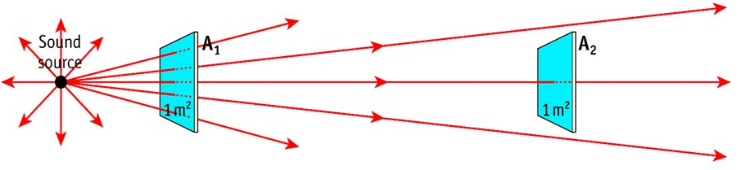
Sound Intensity
More energy passes per second through area A₁ than through A₂. The sound intensity at A₁ is greater than the sound intensity at A₂.

Slide 26
What is the SI Unit of Sound Intensity?
The SI Unit of sound intensity is the watt per metre squared (W ​m​⁻²​).

Slide 27

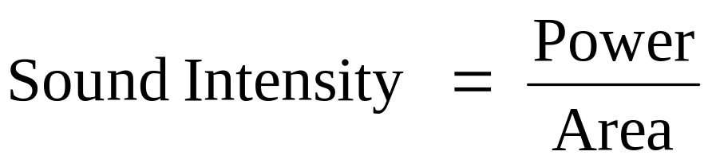
A loudspeaker emits sound uniformly in all directions at a rate of 80 W. Calculate the sound intensity at a distance of 10 m from the loudspeaker.
Imagine a sphere of radius 10 m with the loudspeaker at its centre. All the sound energy passes through this sphere and clearly the sound intensity (I) is the same at every point on the sphere.
Power P = 80 W
Surface area of sphere: A = 4πr^{​2}​ = 4π(10²​) = 1256.63 ​m​²​
= ​(80​)/(1256.63) = 6.37 × ​10​⁻²​ W ​m​^{-2​}

Slide 28
What is meant by the Threshold of Hearing?
The Threshold of Hearing is the smallest sound intensity detectable by the average human ear at a frequency of 1 kHz.

Slide 29
Frequency Response of the Human Ear
The human ear is most sensitive to sounds with frequencies between 2000 Hz and 4000 Hz.

Slide 30
Sound Intensity Level
The Sound Intensity Level Scale is another scale used to measure strength of a sound.
The sound intensity level is measured in a Unit called the decibel (dB).
The definition of this scale and of the decibel is not required in Leaving Certificate Physics.

Slide 31
What is the relationship between Sound Intensity and Sound Intensity Level?
For Leaving Cert. Physics you need to know that:
When the Sound Intensity doubles
the Sound Intensity Level increases by 3 dB.

Slide 32
As a person approaches a loudspeaker the sound intensity increases by a factor of 16 (i.e. the sound intensity is 16 times greater). What is the increase in the sound intensity level (measured in decibels)?
If the sound intensity becomes 16 times greater than its original value, it has doubled 4 times.
X → 2X → 4X → 8X → 16X
Each doubling is an increase in sound intensity level of 3 dB.
Overall increase in sound intensity level
= ​(4)​​(3)​ = 12 dB

Slide 33
The sound intensity level at a concert increases from 90 dB to 96 dB when the concert begins. By what factor has the sound intensity increased?
96 − 90 = 6 dB i.e. two increases of 3 dB
Each 3 dB increase corresponds to a doubling of the sound intensity.
Therefore the sound intensity has doubled twice.
i.e. The sound intensity has increased by a factor of 4.

Slide 34
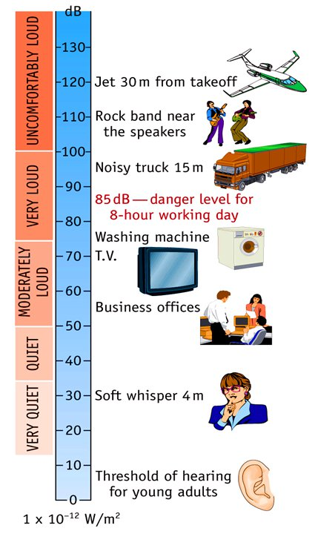

Slide 35
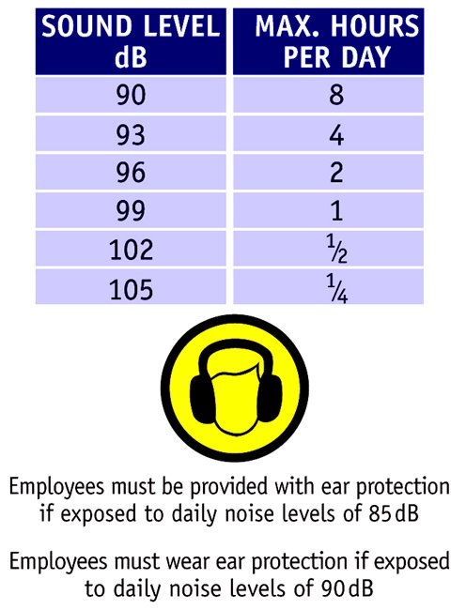

Slide 36
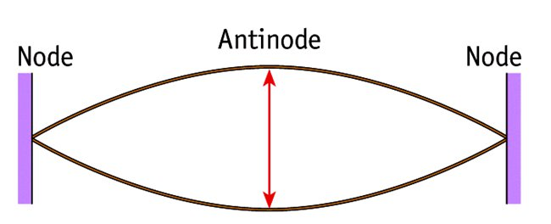
What is meant by the Fundamental Frequency of a String?
A string vibrating with an Antinode at its centre, a Node at each end and no other nodes or antinodes is vibrating at its Fundamental Frequency.

Slide 37
What is the relationship between the Fundamental Frequency of a stretched string and its Length?
The Frequency is Inversely Proportional to its Length.

Slide 38
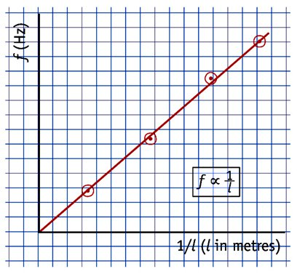
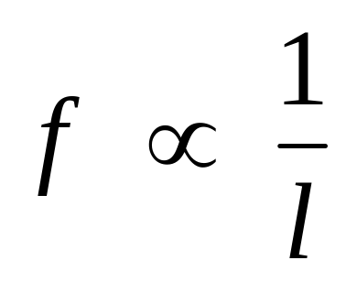
The Fundamental Frequency of a stretched string is Inversely Proportional to its Length.

Slide 39
What is the relationship between the Fundamental Frequency of a stretched string and its Tension?
The Frequency is Directly Proportional to the square root of the Tension.

Slide 40
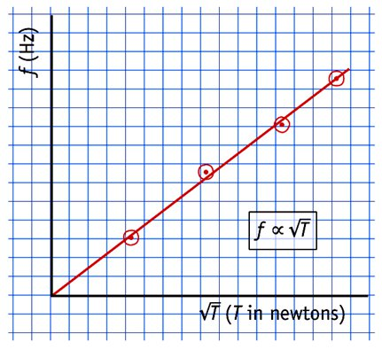
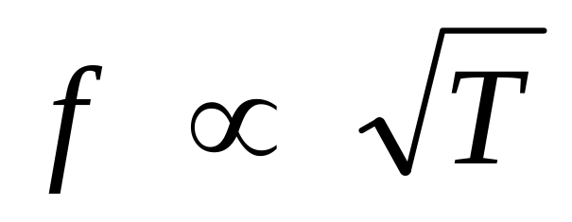
The Fundamental Frequency of a stretched string is Directly Proportional to the Square Root of its Tension.

Slide 41
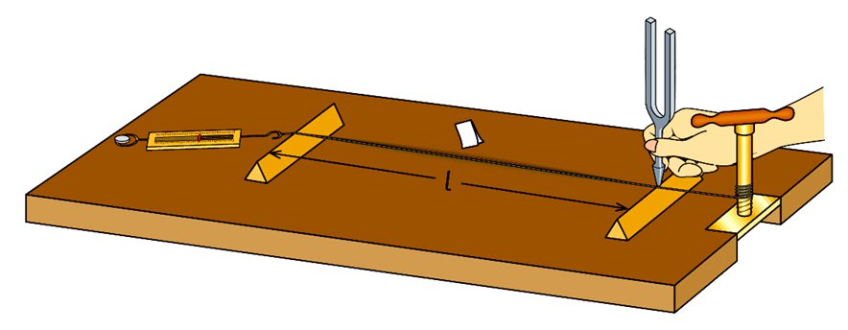
A Sonometer
Small paper rider
Tuning fork
Winder to adjust tension
Newton balance
Movable Bridge
Wooden sounding board
Movable bridge

Slide 42
What are Harmonics?
Frequencies that are multiples of a certain frequency f are called Harmonics.
f is called the Fundamental Frequency or the First Harmonic,
2f is the Second Harmonic,
3f is the Third Harmonic etc.

Slide 43
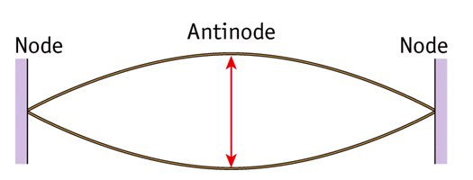
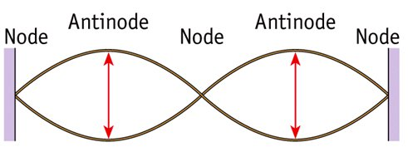
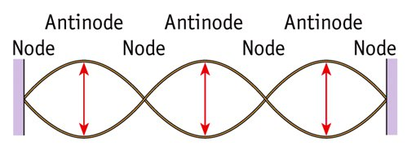
A string may vibrate at frequencies other then its fundamental frequency f.
The diagrams show the same string vibrating at a frequency of 2 f and 3 f.
In general when a string is plucked or bowed, it vibrates with some or all of these modes of vibration together.

Slide 44
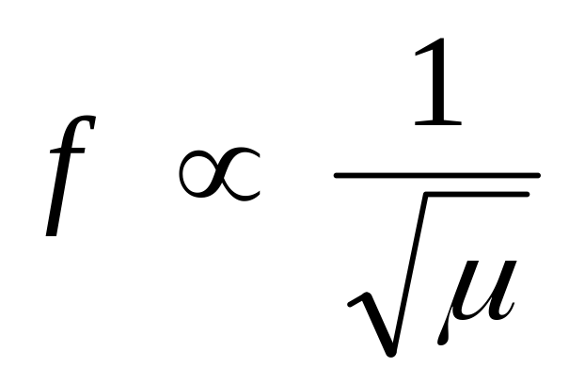
What is the relationship between the Fundamental Frequency of a stretched string and its Mass per unit length?
The Frequency is Inversely Proportional to the Square Root of its Mass per unit Length (μ).

Slide 45
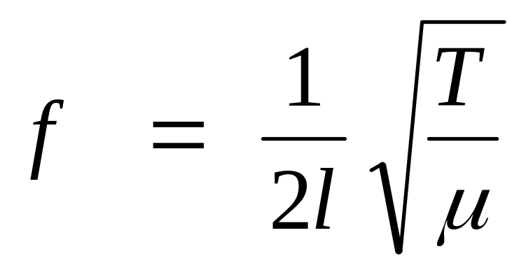
f is the Fundamental Frequency of a stretched string.
l is the Length of the string.
T is the Tension in the string.
μ is the Mass Per Unit Length of the string.

Slide 46
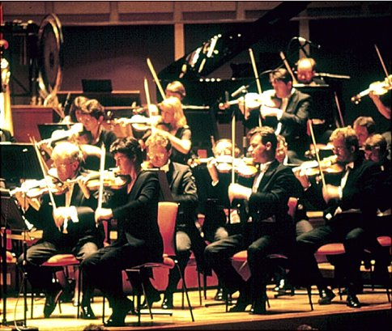
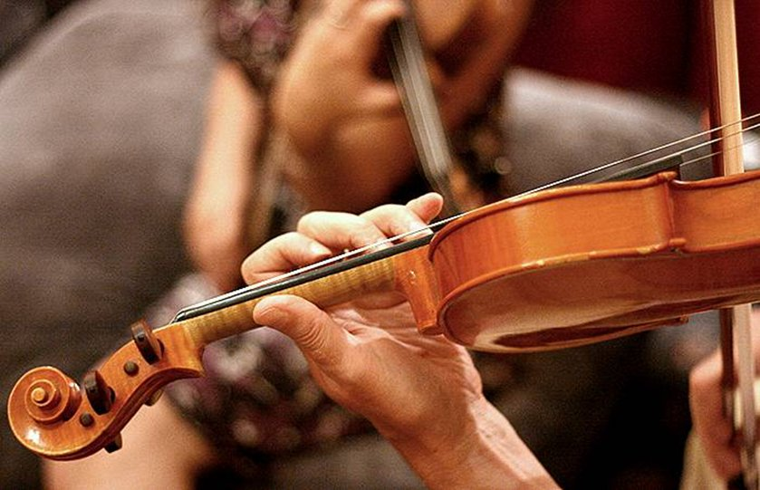
String Section of an Orchestra

Slide 47
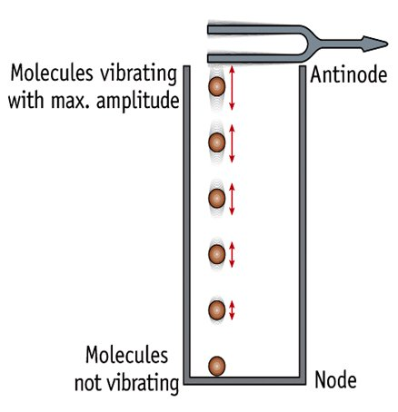
Stationary Waves in a Pipe (closed at one end)
A longitudinal sound wave from the tuning fork travels down the pipe.
It reflects from the bottom and travels back up.
The incident and reflected wave interfere.
If the length of the pipe is varied, at certain lengths resonance will occur and a stationary longitudinal wave is set up in the pipe.
There is a node at the bottom of the pipe and an antinode at the top of the pipe.

Slide 48
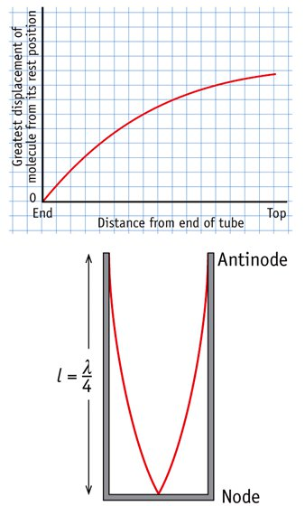
Stationary Waves in a Pipe (closed at one end)
Since the distance between a node and the next antinode in a stationary wave is λ /4,
The length of the pipe = λ /4
i.e. l = λ /4
This is shown graphically in the diagram.

Slide 49
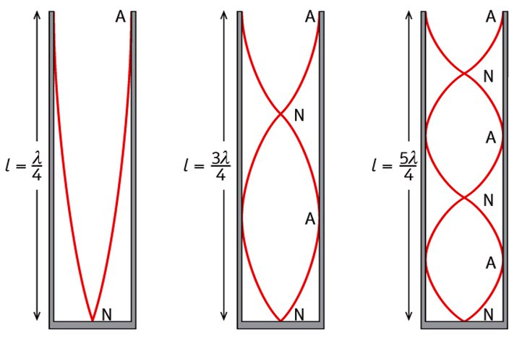
Stationary Waves in a Pipe (closed at one end)
The diagram shows the next simplest stationary waves that can occur in a pipe closed at one end.

Slide 50
The Clarinet, Trombone and the Saxophone are instruments in which air resonates in a pipe closed at one end.

Slide 51

In a Pipe Closed at One End only the Odd Numbered Harmonics may be present.
i.e. only frequencies of f, 3f, 5f, 7f . . . .
In the diagram each pipe has the same length l.
The wavelengths of the waves are:
λ₁ = 4l
λ₂ = 4l / 3 and
λ₃ = 4l / 5
The frequencies are therefore
f, 2f and 3f

Slide 52
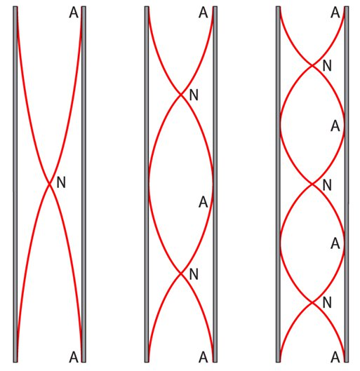
Stationary Waves in a Pipe Open at Both Ends
In an open pipe there must be an antinode at each end.
The diagram shows the simplest stationary waves that can occur.

Slide 53
In a Pipe Open at Both Ends what harmonics may be present?
All Harmonics may be present,
i.e. f, 2f, 3f, 4f, 5f, 6f . . . . .
The Flute, the Tin Whistle and the Recorder are musical instruments in which air resonates in a pipe open at both ends.

Slide 54
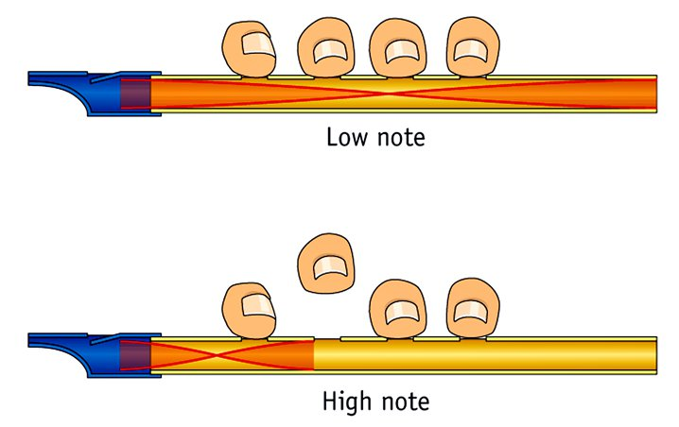
In an Open Pipe all Harmonics may be present
The Flute, the Tinwhistle and the Recorder are instruments in which air resonates in a pipe that is open at both ends.

